Slide 1
EC544 Team 1 – Challenge 3 Remote Access
Abdulaziz Alhassan
Damini Ashok Chopra
Konstantino Sparakis,
Wenyng Zhang

Slide 2
Design Decisions
Dynamic DNS and Port Forwarding techniques are implemented for Remote Access.
The Dynamic DNS is hosted at site www.noip.com (a free DDNS site).
IP address of laptop is sent and stored on this site
Phone is a TCP client, computer has a TCP sever
Android app sends on or off commands for specific LED.

Slide 3
Technologies
Dynamic DNS
Port Forwarding
Android Java API
SeverSocket in java

Slide 4
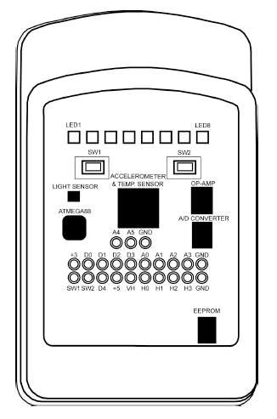

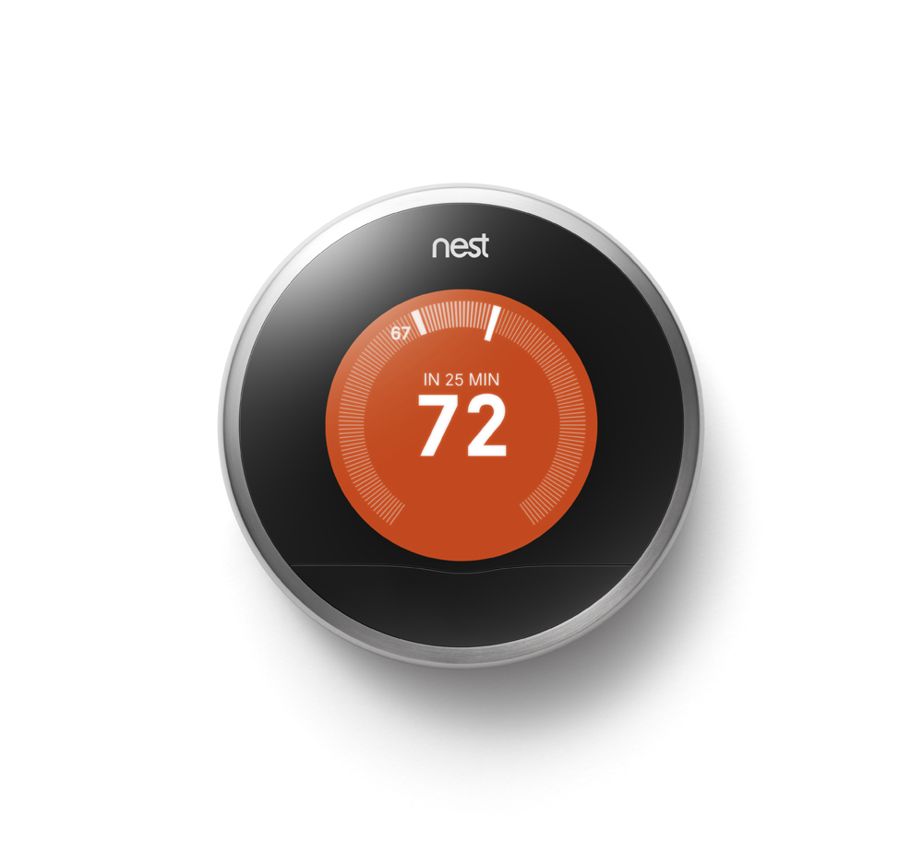
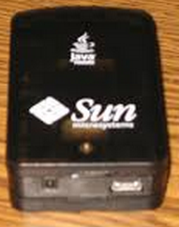
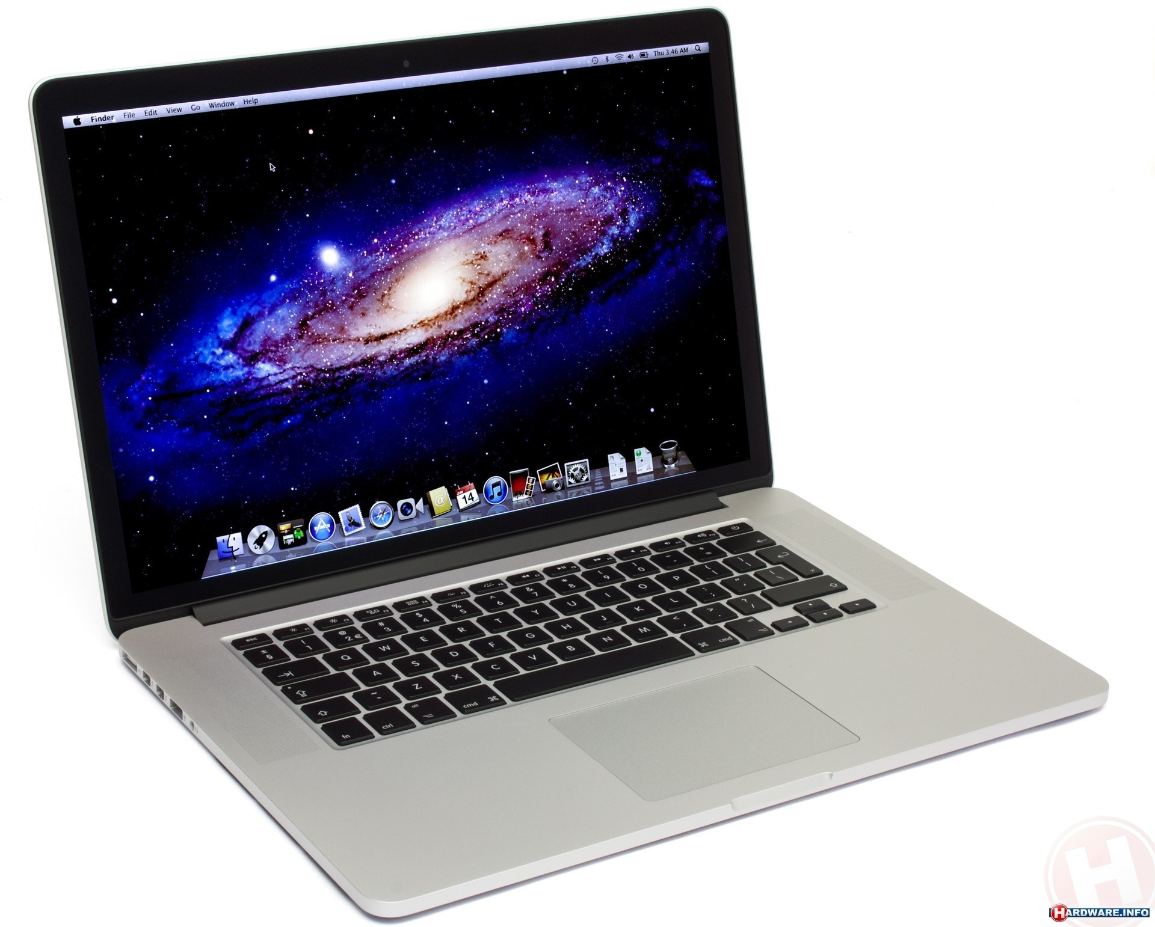

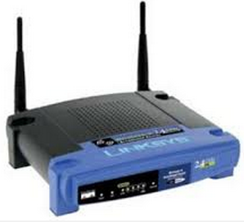

Data Flow
Phone
Android SDK
Laptop
Internet
Port Forwarding
TCP : 5000, 80
DDNS

Slide 5
Challenges
Network Delay & Synchronization
Port forwarding performance (delay)
Handling network interruptions between client and sunspot
Apache sever is faulty
Setup Dynamic DNS
Setup the router

